Slide 1

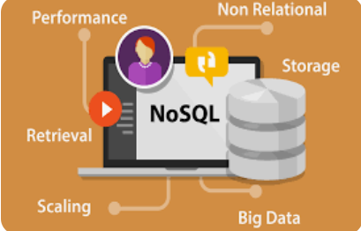
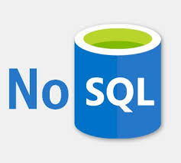
Introduction To NoSQL
Prepared By: Dr. Ronak Panchal , Ph.D in Computer Science
IT Project Manager, Cognizant, Pune
Website blog: http://drronakpanchal.wordpress.com

Slide 2
Agenda
History & Jargon’s of NoSQL
Introduction NoSQL and its types
Usecase of NoSQL
Prons and Cons of NoSQL
Why Should we Use NoSQL Database?
SQL vs NoSQL
Demo
Create DB in mongoDB
Create Graph DB in Neo4j

Slide 3



Let’s explore the NoSQL’s universe

Slide 4
History of NoSQL
The term NoSQL was used by Carlo Strozzi in 1998
Johan Oskarsson, then a developer at Last.fm, reintroduced the term NoSQL in early 2009 when he organized an event to discuss "open-source distributed, non-relational databases".
The name attempted to label the emergence of an increasing number of non-relational, distributed data stores, including open source clones of Google's Bigtable/MapReduce and Amazon's DynamoDB.

Slide 5
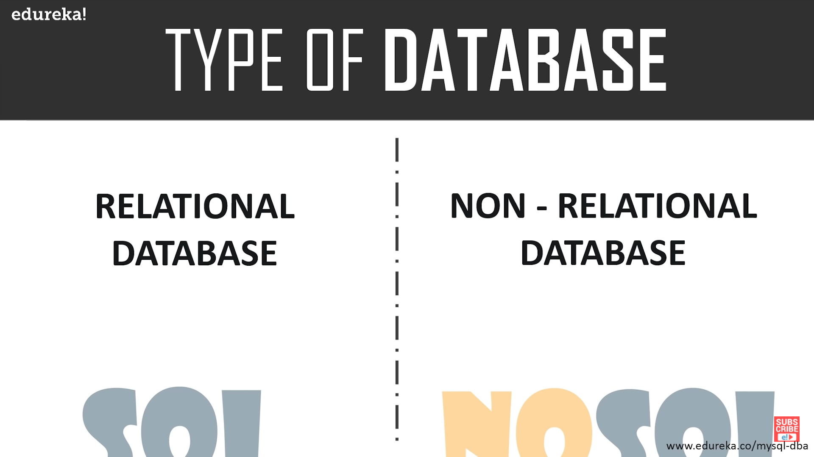
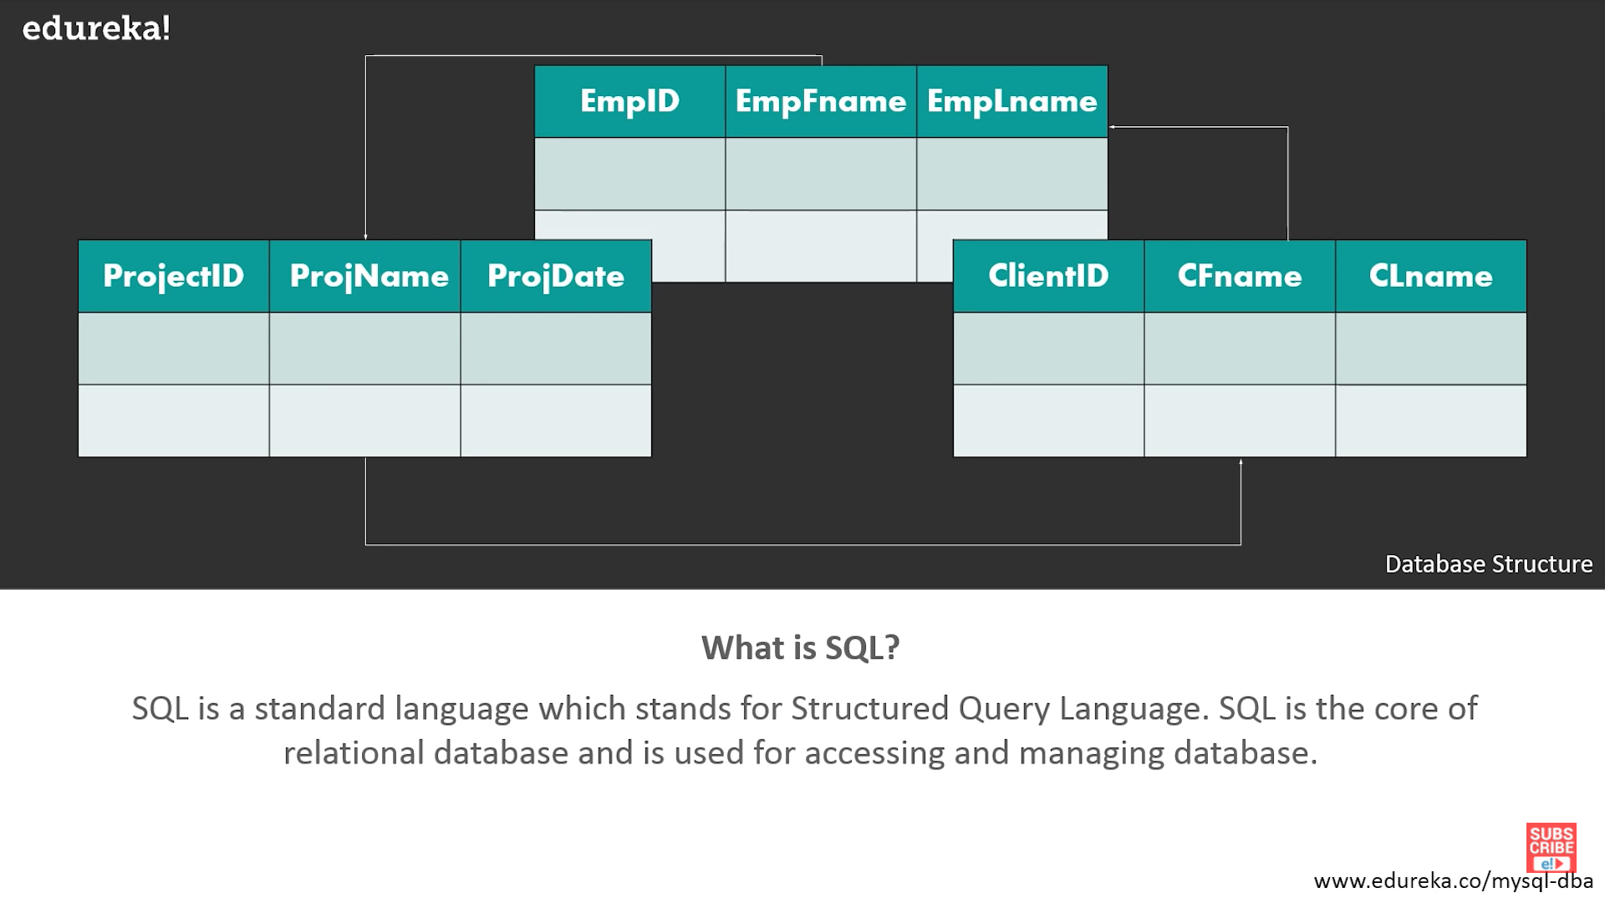

Slide 6
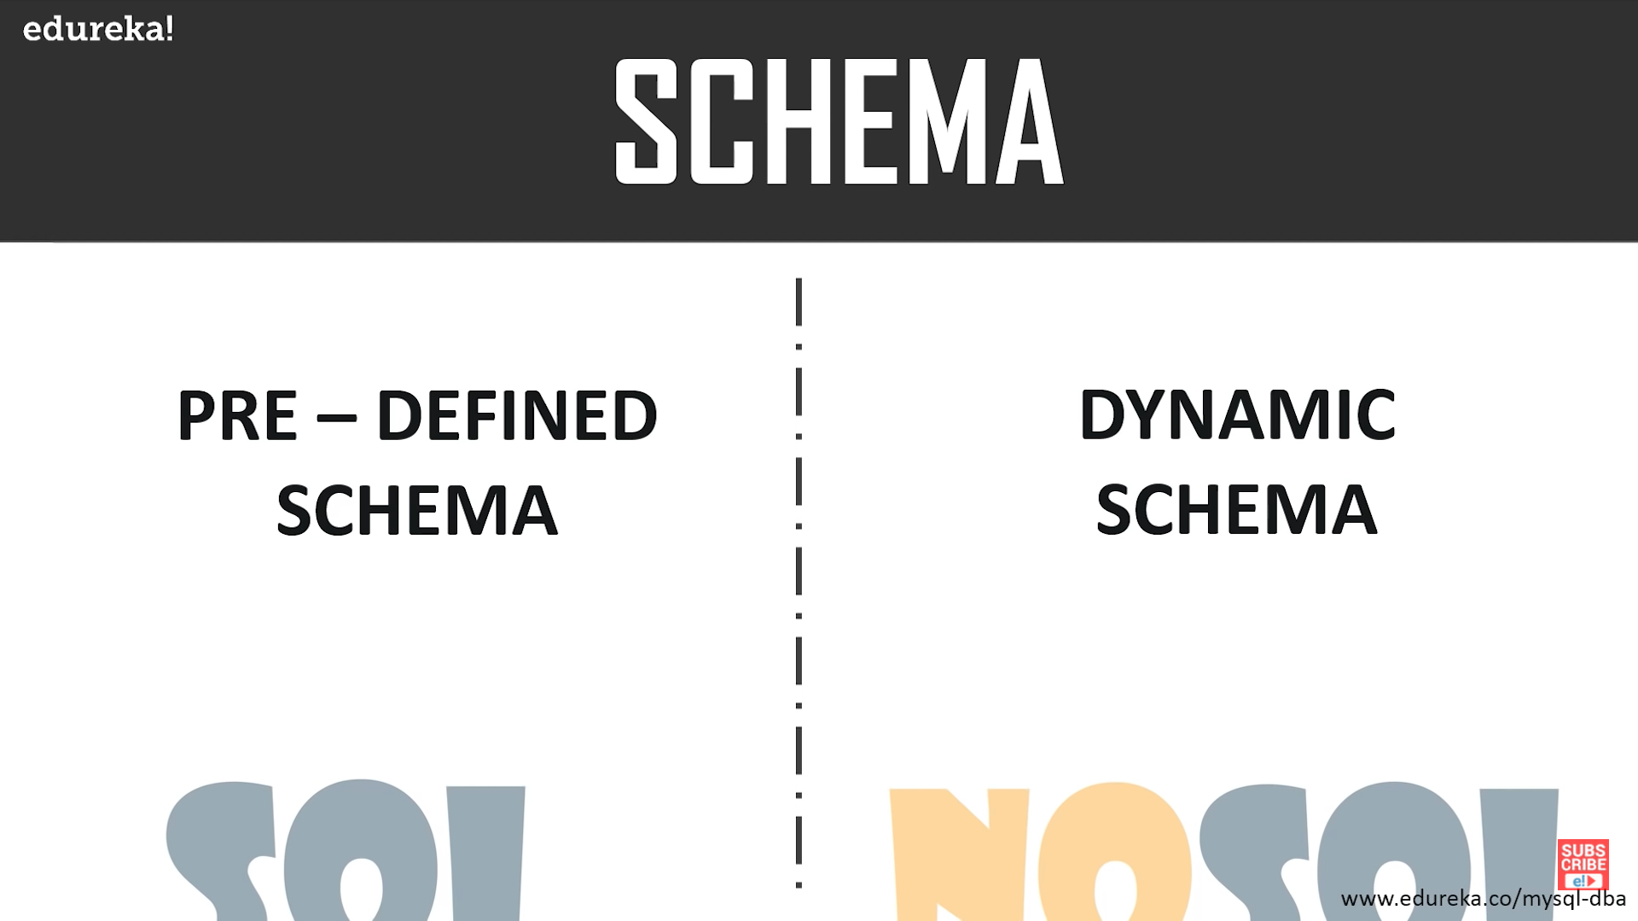

Slide 7
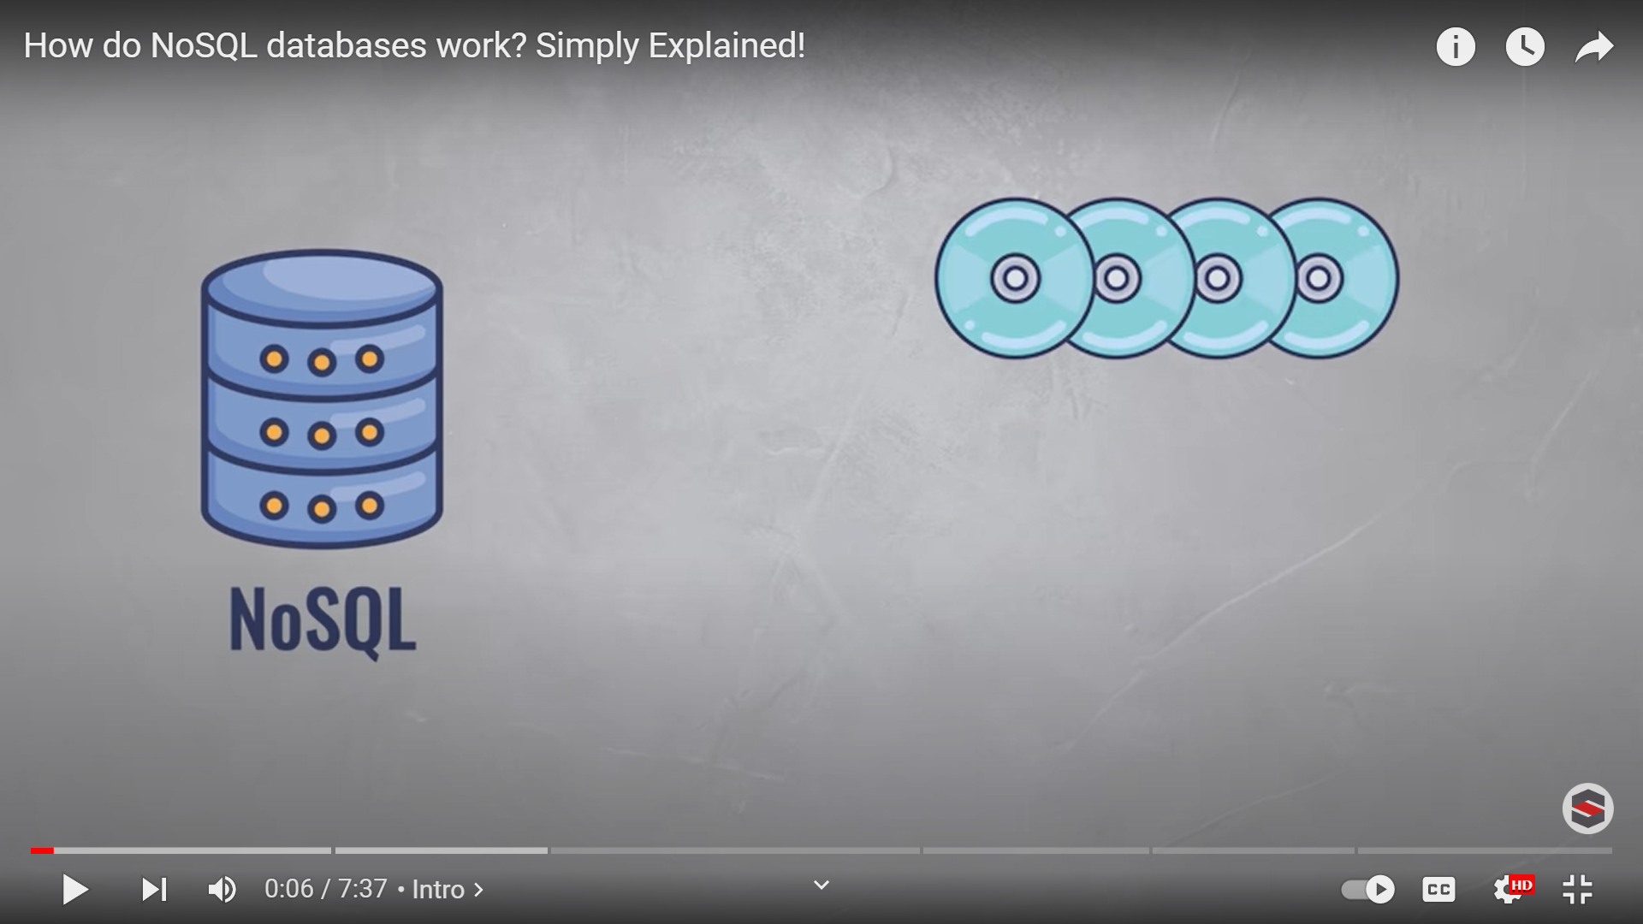
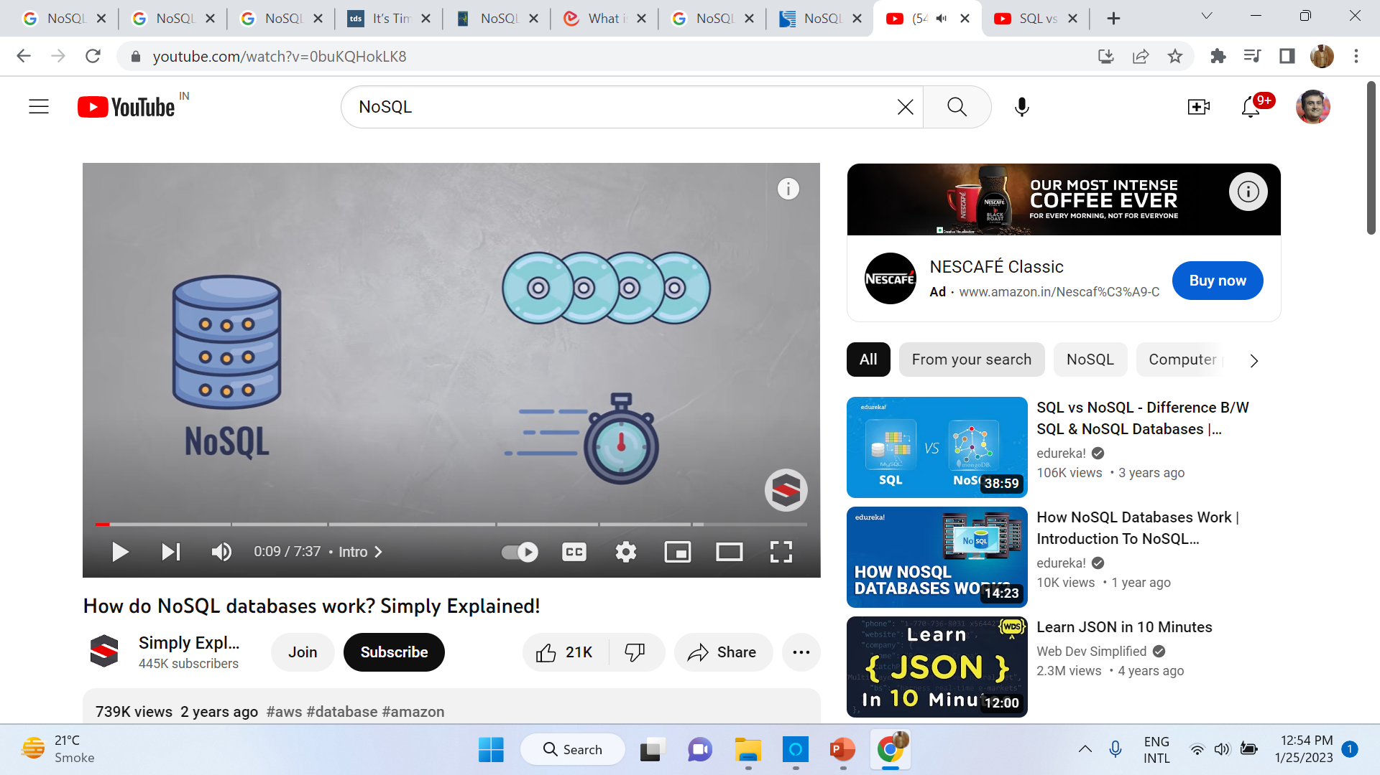

Slide 8
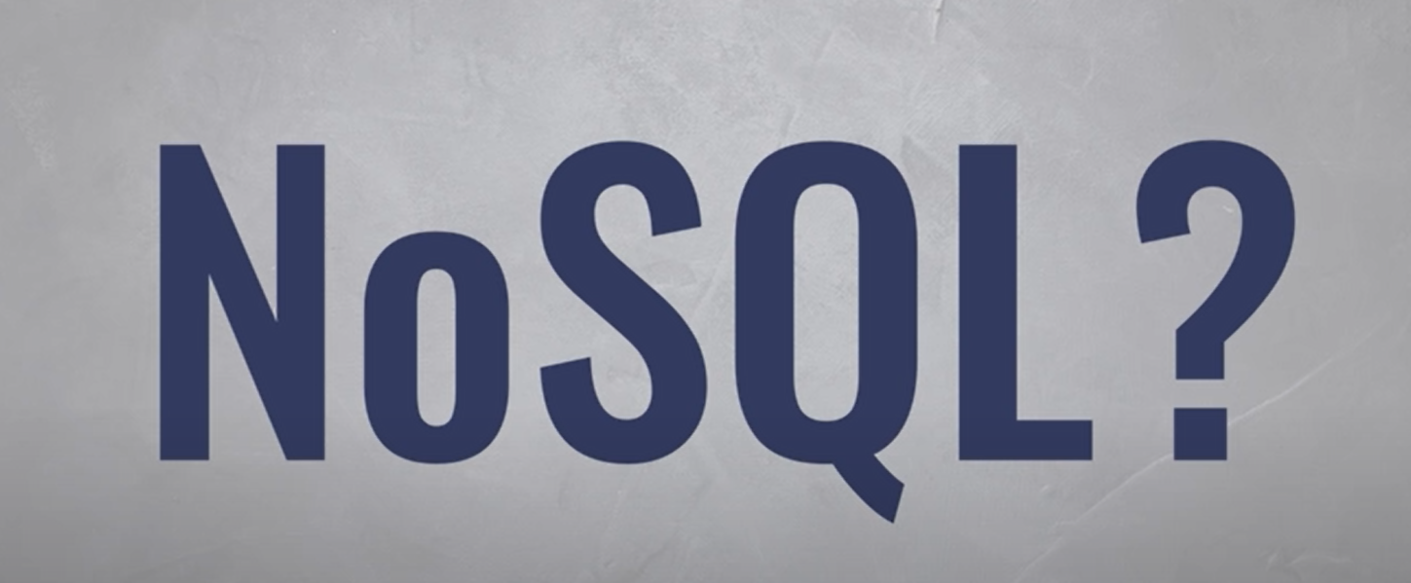

Slide 10
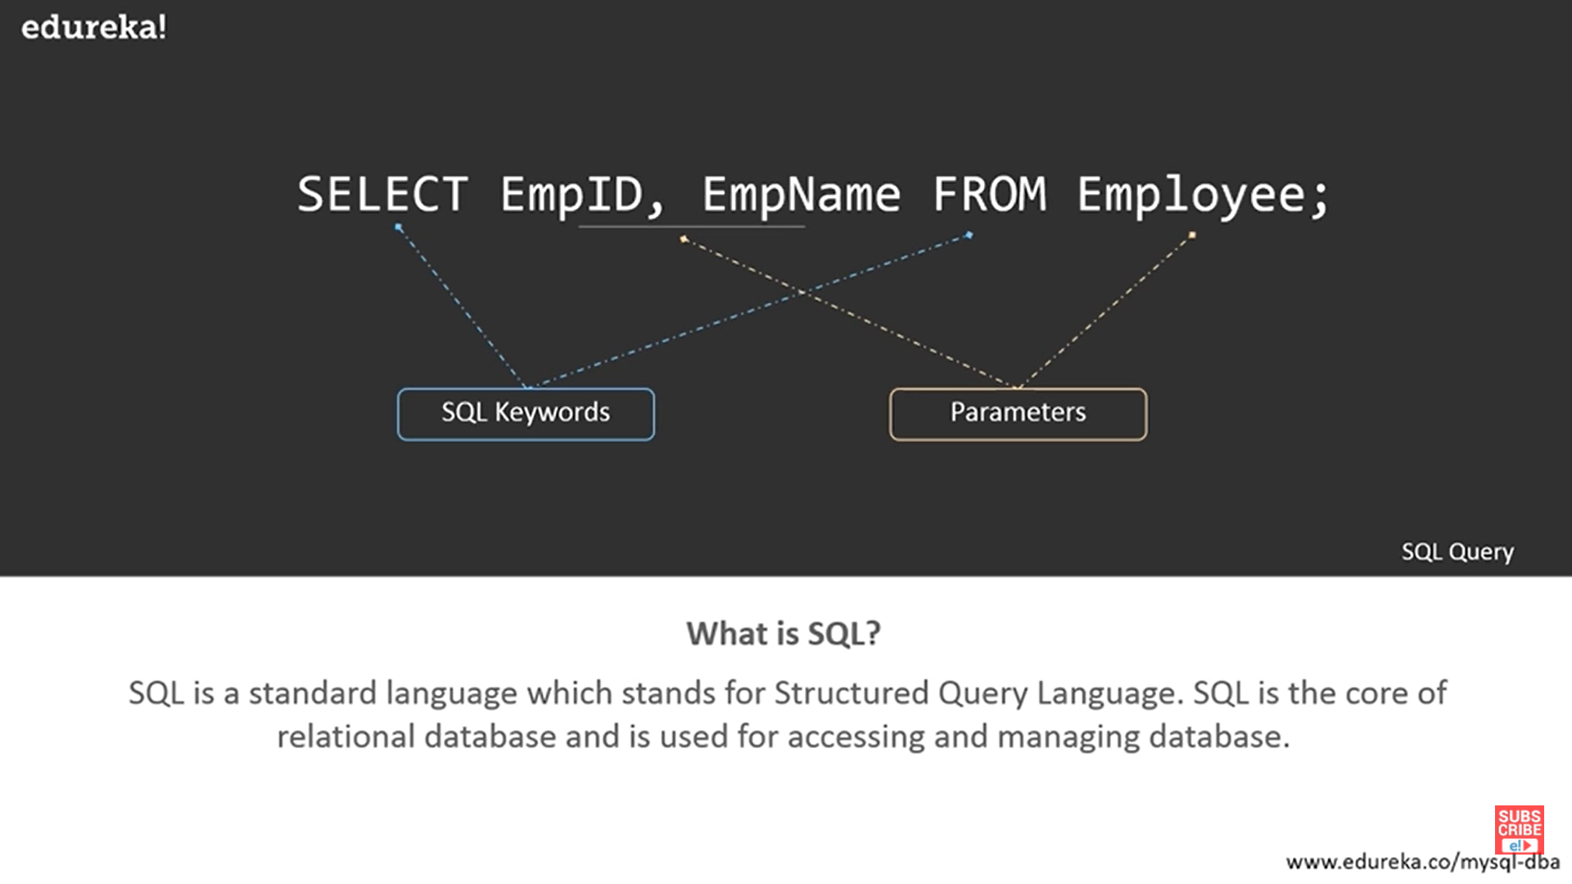

Slide 11
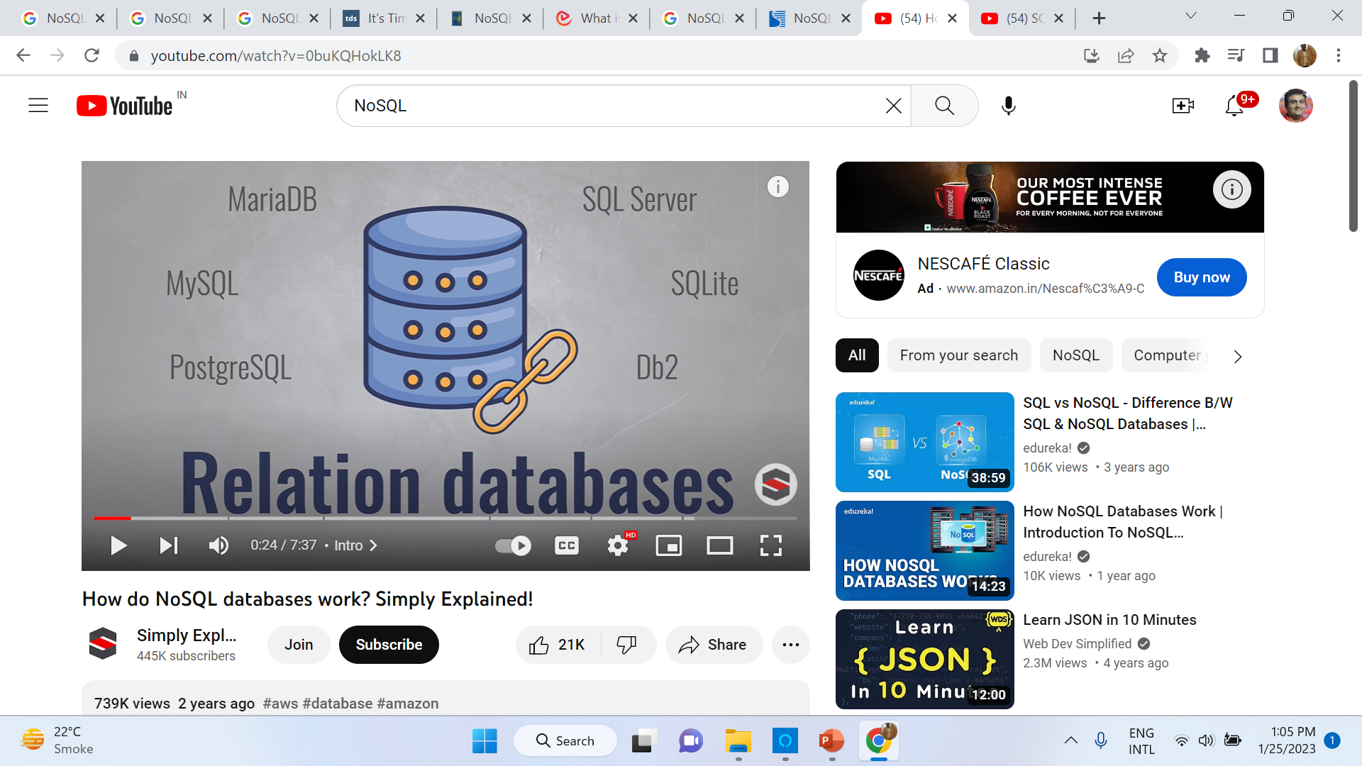

Slide 12

What is NoSQL…?

Slide 13
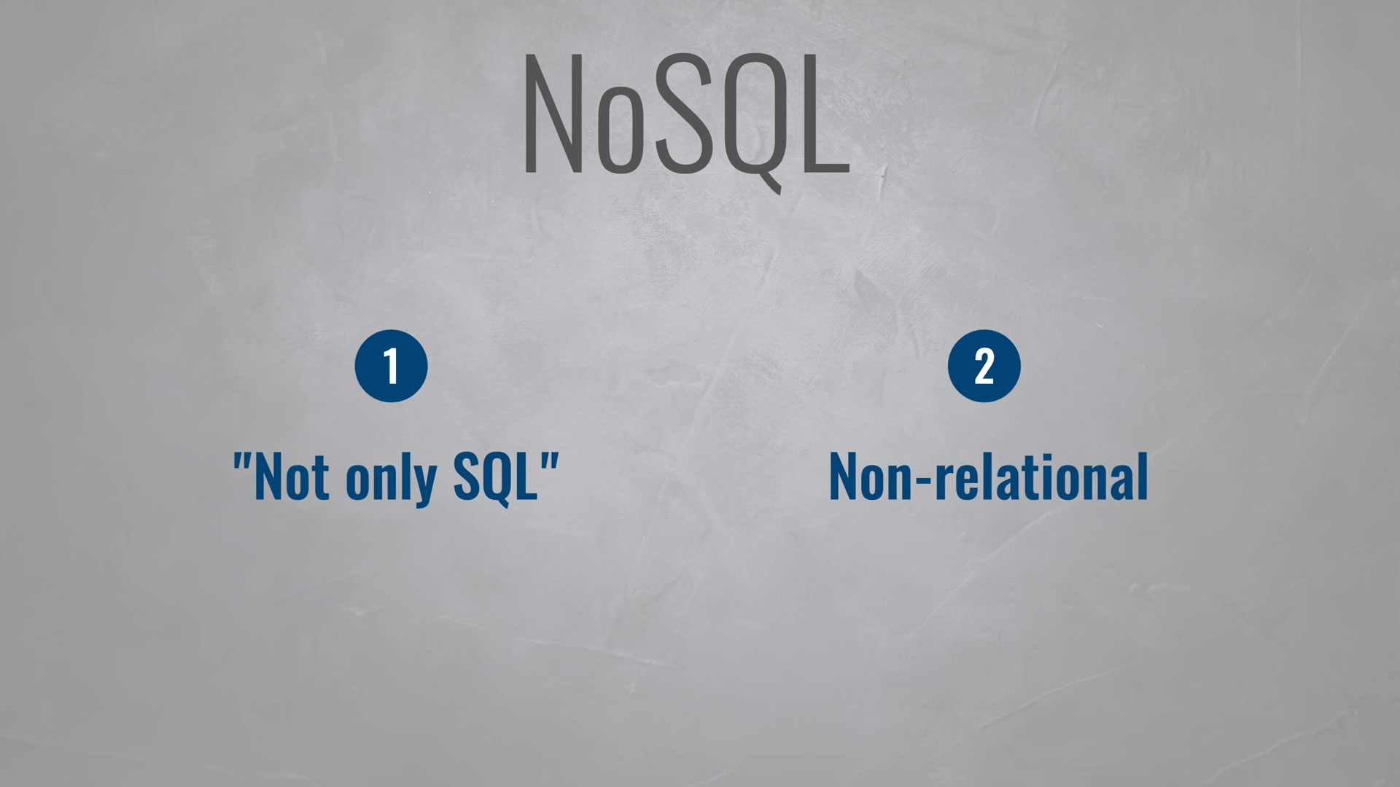
Or Non-SQL

Slide 14
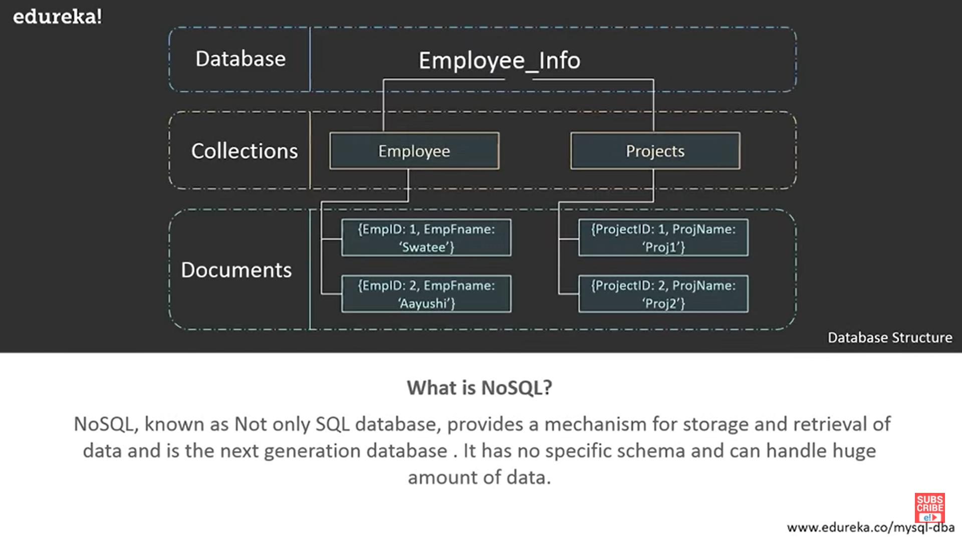

Slide 15
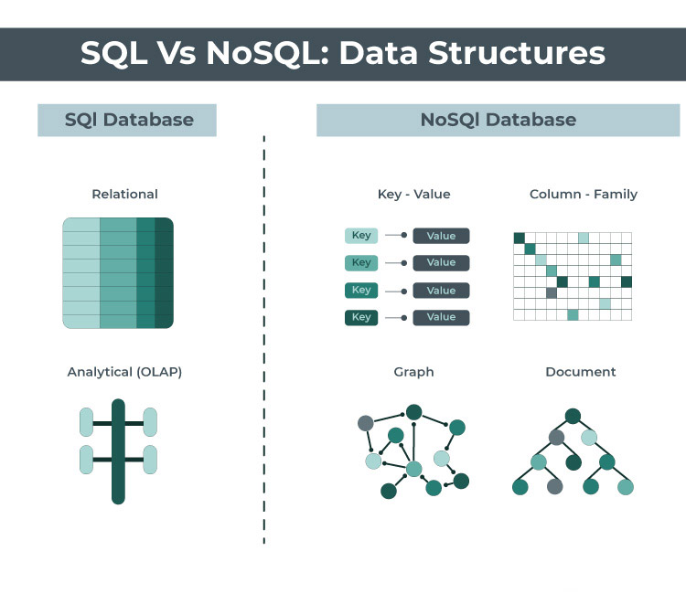
NoSQL, or “not only SQL,” is a class of databases designed for more flexible data management than relational databases.
NoSQL databases come in many different shapes and sizes, but they all have one thing in common – they don’t use the traditional table-based structure of relational databases.
These types of databases are also known as ‘Not only SQL’, ‘non-SQL’ or ‘non-relational databases, as it also allows and supports SQL programming languages.
The NoSQL databases are progressively applied to big data applications, as well as many other web-based applications.

Slide 16
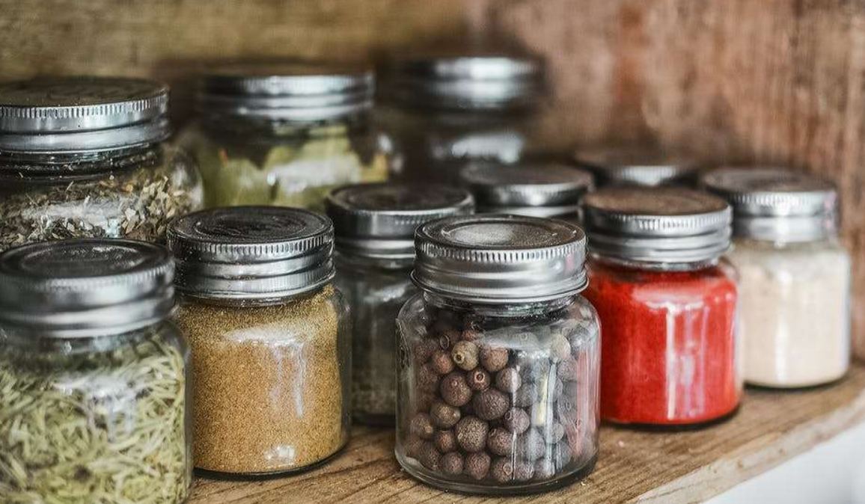
Understand the structure of NoSQL

Slide 17
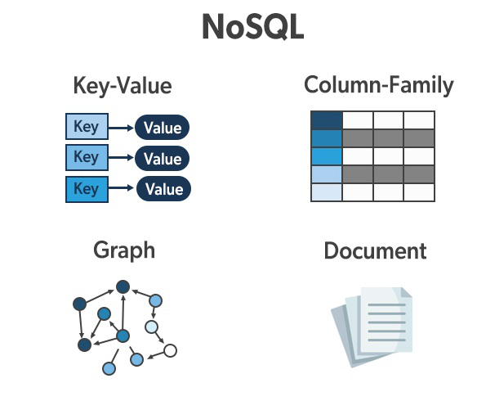

Slide 18
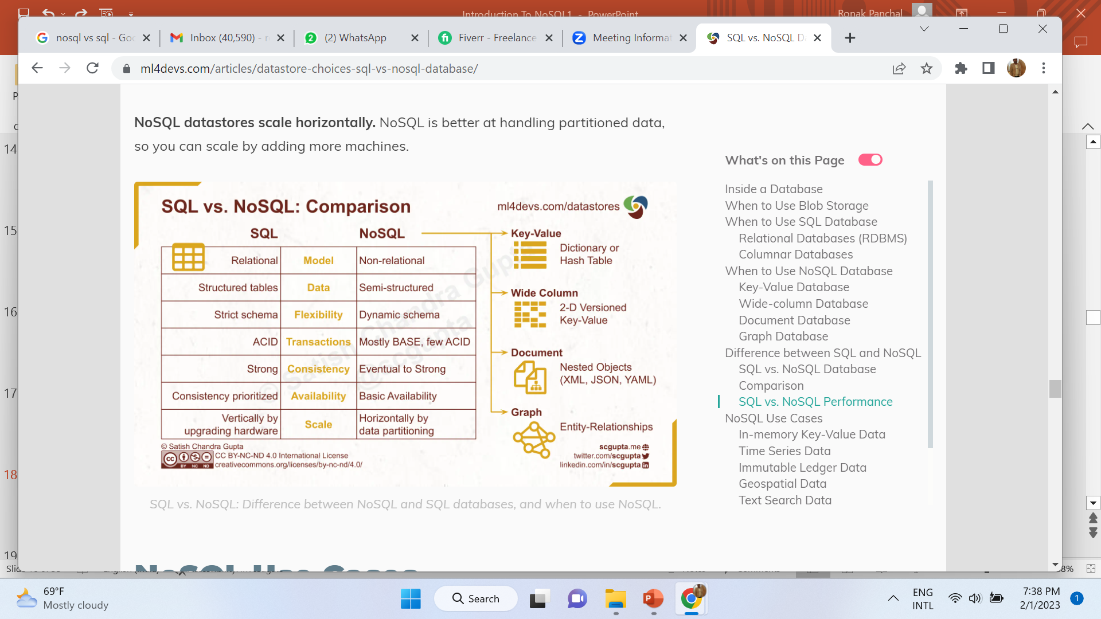
https://www.ml4devs.com/articles/datastore-choices-sql-vs-nosql-database/

Slide 19
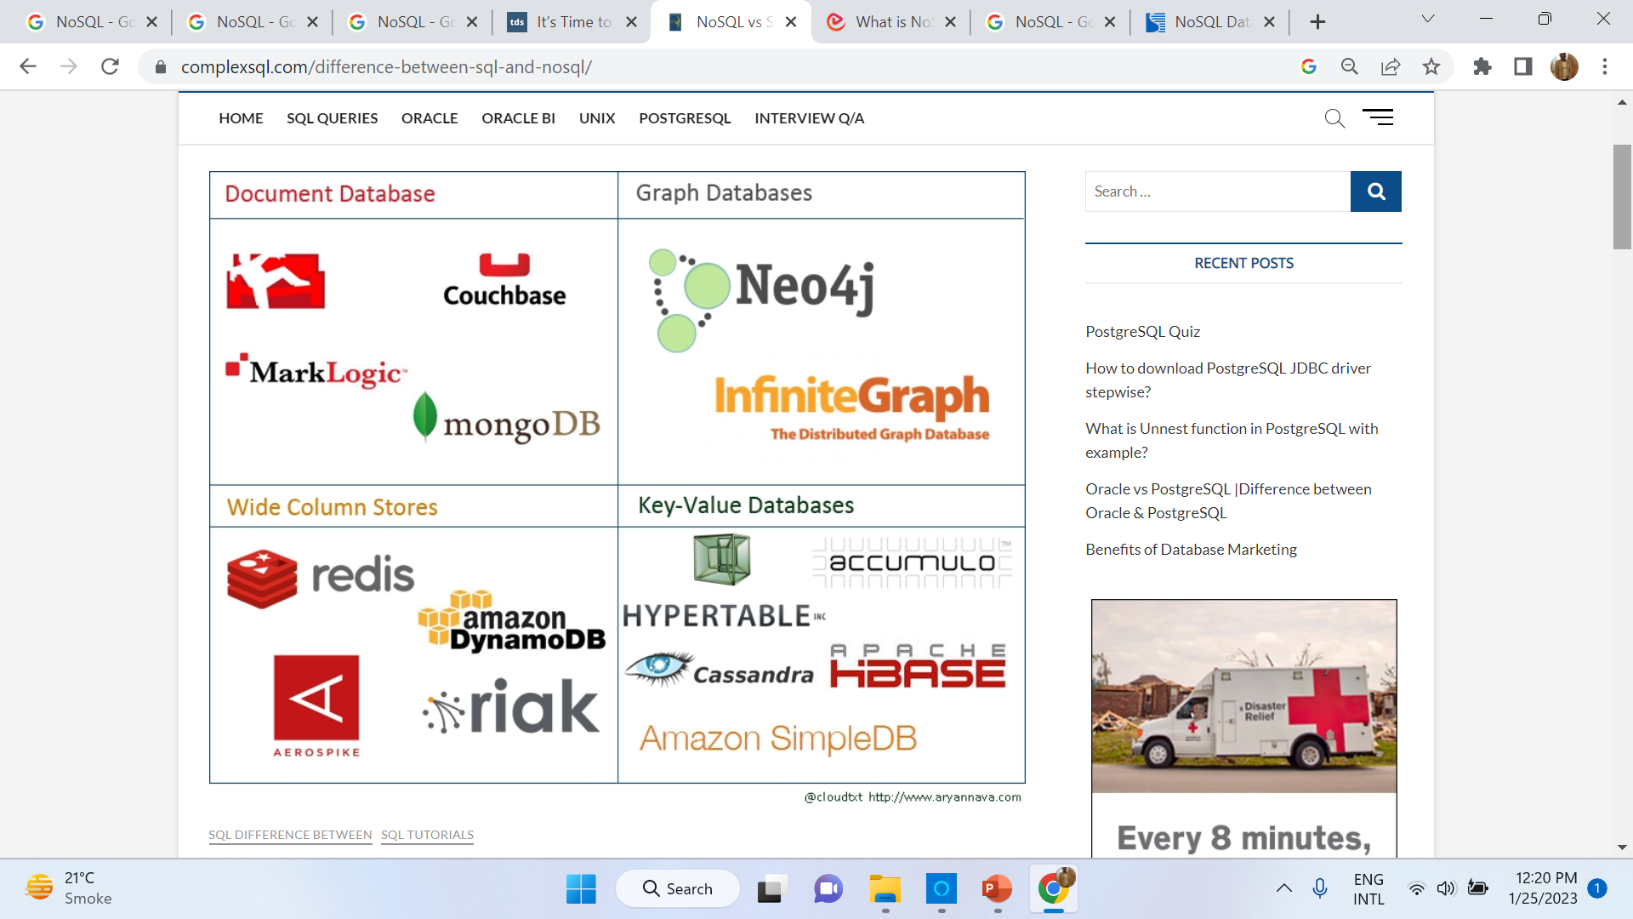
Type & Example of NoSQL
Source: https://www.complexsql.com/difference-between-sql-and-nosql/

Slide 20
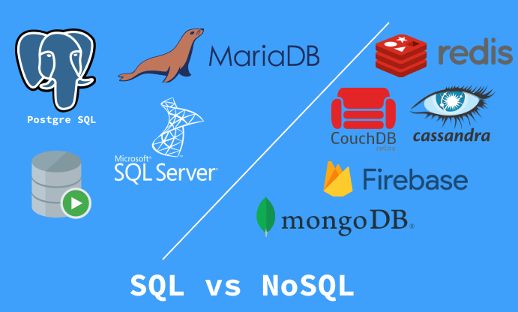

Slide 21
Parameter | SQL | NOSQL
Definition | SQL databases are primarily called RDBMS or Relational Databases | NoSQL databases are primarily called as Non-relational or distributed database
Design for | Traditional RDBMS uses SQL syntax and queries to analyze and get the data for further insights. They are used for OLAP systems. | NoSQL database system consists of various kind of database technologies. These databases were developed in response to the demands presented for the development of the modern application.
Query Language | Structured query language (SQL) | No declarative query language (Cypher, SPARQL, GQL, or many)
Type | SQL databases are table based databases | NoSQL databases can be document based, key-value pairs, graph databases
Schema | SQL databases have a predefined schema | NoSQL databases use dynamic schema for unstructured data.
Ability to scale | SQL databases are vertically scalable | NoSQL databases are horizontally scalable
Best suited for | An ideal choice for the complex query intensive environment. | It is not good fit complex queries.
Hierarchical data storage | SQL databases are not suitable for hierarchical data storage. | More suitable for the hierarchical data store as it supports key-value pair method.
Variations | One type with minor variations. | Many different types which include key-value stores, document databases, and graph databases.
Development Year | It was developed in the 1970s to deal with issues with flat file storage | Developed in the late 2000s to overcome issues and limitations of SQL databases.
Open-source | A mix of open-source like Postgres & MySQL, and commercial like Oracle Database. | Open-source
https://www.guru99.com/sql-vs-nosql.html

Slide 22
Parameter | SQL | NOSQL
Open-source | A mix of open-source like Postgres & MySQL, and commercial like Oracle Database. | Open-source
Consistency | It should be configured for strong consistency. | It depends on DBMS as some offers strong consistency like MongoDB, whereas others offer only offers eventual consistency, like Cassandra.
Best Used for | RDBMS database is the right option for solving ACID problems. | NoSQL is a best used for solving data availability problems
Importance | It should be used when data validity is super important | Use when it’s more important to have fast data than correct data
Best option | When you need to support dynamic queries | Use when you need to scale based on changing requirements
Hardware | Specialized DB hardware (Oracle Exadata, etc.) | Commodity hardware
Network | Highly available network (Infiniband, Fabric Path, etc.) | Commodity network (Ethernet, etc.)
Storage Type | Highly Available Storage (SAN, RAID, etc.) | Commodity drives storage (standard HDDs, JBOD)
Best features | Cross-platform support, Secure and free | Easy to use, High performance, and Flexible tool.
Top Companies Using | Hootsuite, CircleCI, Gauges | Airbnb, Uber, Kickstarter
Average salary | The average salary for any professional SQL Developer is $84,328 per year in the U.S.A. | The average salary for “NoSQL developer” ranges from approximately $72,174 per year

Slide 23
Popular Database names
Examples of SQL databases
Examples of NoSQL databases
Db2
MySQL
PostgreSQL
YugabyteDB
CockroachDB
Oracle Database
Microsoft SQL Server
Azure SQL Database
Redis
FaunaDB
CouchDB
MongoDB
Cassandra
Elasticsearch
BigTable
Neo4j
HBase

Slide 24
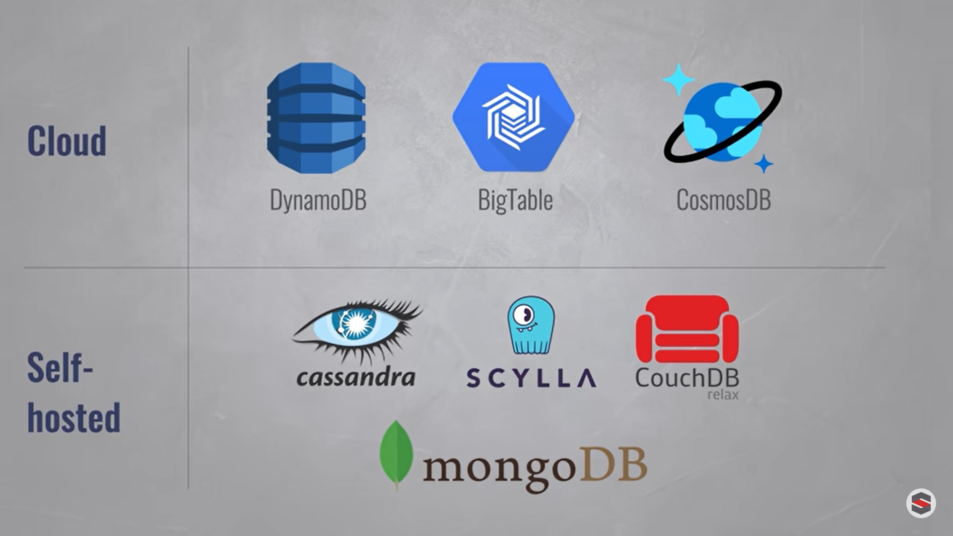

Slide 25
NoSQL Use Cases
Fraud detection and identity authentication.
Inventory and catalog management.
Personalization, recommendations and customer experience.
Internet of things (IoT) and sensor data.
Financial services and payments.
Messaging and ChatBot
Logistics and asset management.
Content management systems.
Digital and media management
Real-Time Big Data Processing.
For Mobile Applications.
https://www.datastax.com/blog/sql-vs-nosql-whats-the-difference

Slide 26
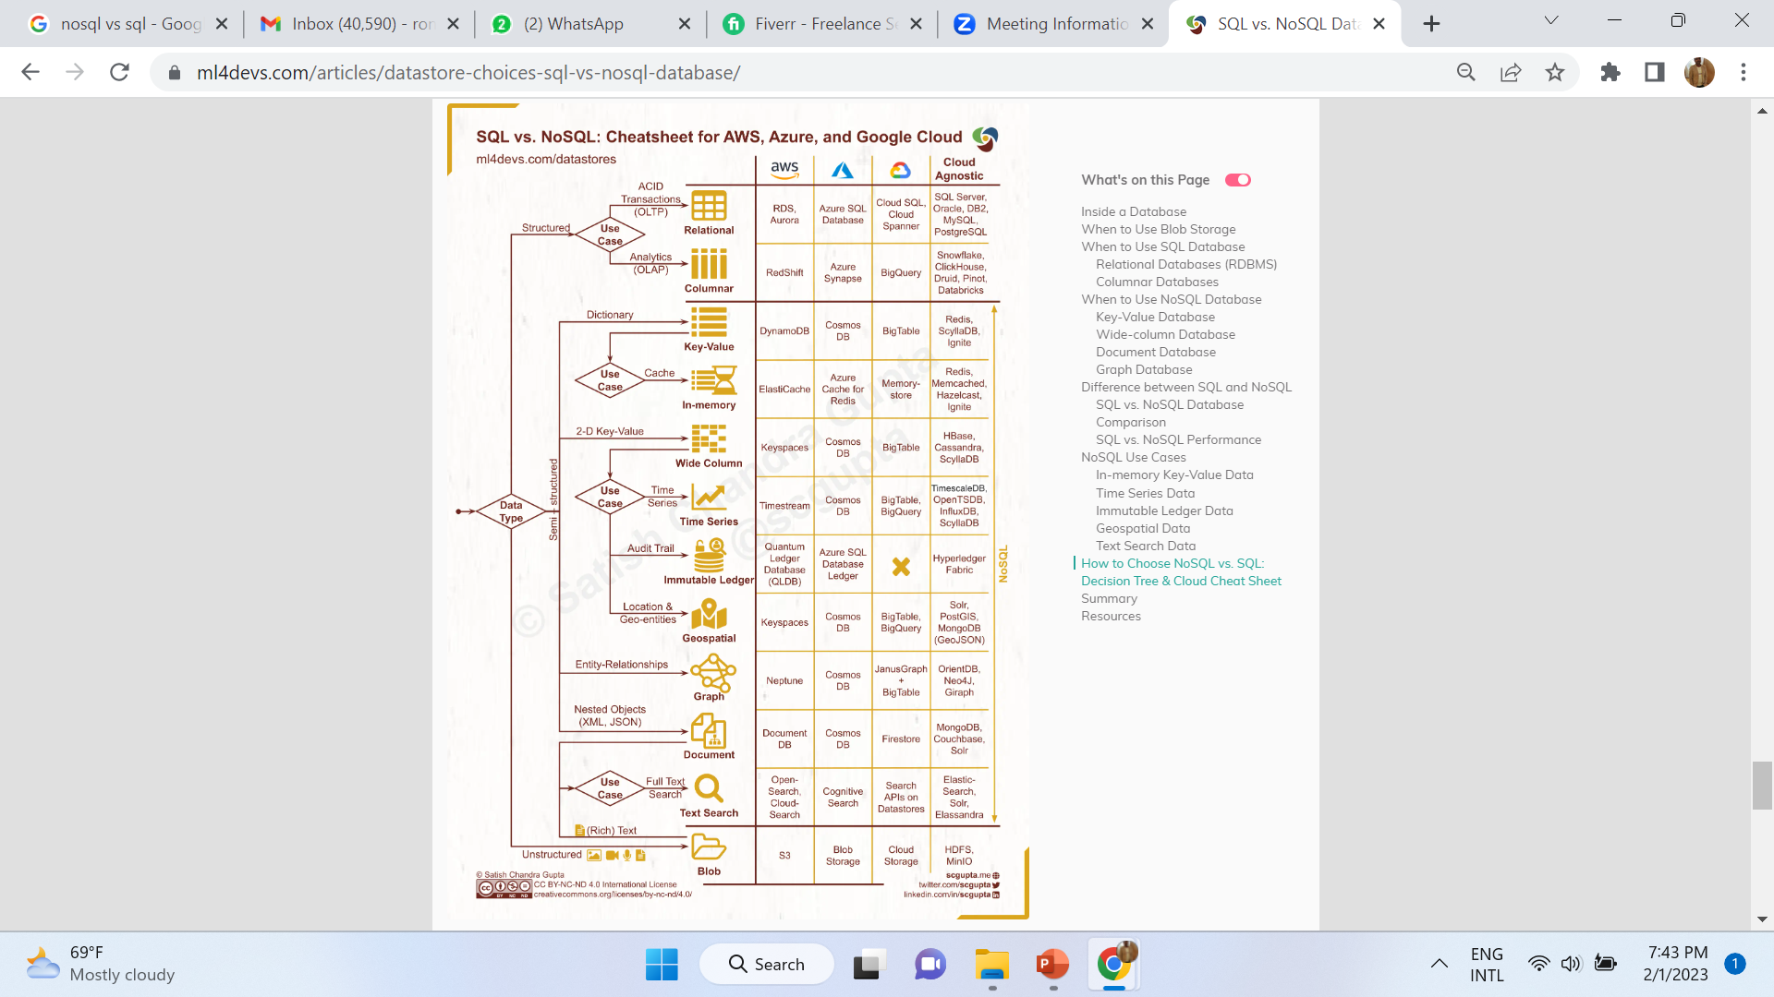

Slide 27
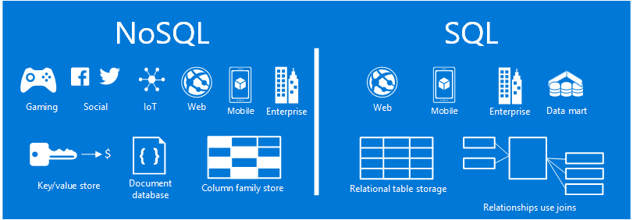

Slide 28
Pron’s of NoSQL
High scalability
High availability
Big data capability
Easy replication
Fast performance
High flexibility

Slide 29
Con’s of NoSQL
Narrow focus
Open-source
Management challenge
GUI not available
Large document size

Slide 30
Why Should we Use NoSQL Database?
Analytics: NoSQL database is suitable for doing analytical queries. Querying language used for atomic queries can also be used for analytical queries.
Scale: The database is preferred because it is designed to scale. They are designed to easily scale out when they grow. Data is divided and balanced among multiple nodes in a cluster, and by default, aggregate queries are divided.
Redundancy: The database is designed while keeping redundancy in concern. The database is designed to handle hardware failures instead of treating them. The problem of hardware failure is handled during the time of development.
Flexibility: There is huge flexibility in how the data is stored, which increases the performance in the NoSQL database.
Rapid Development: The database provides an easy way to change the way data is stored or change the queries that are running. Batch processing and simple refactoring are done to accomplish massive changes.
https://www.educba.com/what-is-nosql-database/

Slide 31
Critical Differences Between SQL and NoSQL
Data Structures: The biggest difference between SQL and NoSQL databases is their data structures. As we mentioned before, SQL databases use a table-based structure, while NoSQL databases can use various data structures. This difference is crucial because it affects how data is stored and accessed. In a relational database, data is typically stored in rows and columns. This can make it difficult to store complex data types, such as sensor data, social media posts, documents, article content or images.
Query Languages: SQL is a declarative language, which means that you specify what you want to retrieve from the database, and the database figures out how to retrieve it. In contrast, NoSQL databases use a variety of query languages, including GraphQL, SPARQL, Cypher, Xquery, MapReduce, and Apache Hive.
Indexing: Indexing is a way of optimizing the performance of a database by creating an index that you can use to retrieve data quickly. Both SQL and NoSQL databases support indexing, but they achieve this differently. In a relational database (SQL), indexes are typically created on columns. In a NoSQL database, you can create indexes on any data type, including documents and keys.
Transactions: A transaction is a unit of work that is either completed successfully or not. Both SQL and NoSQL databases support transactions, but they use different methods. In a relational database (SQL), transactions are typically managed by the database. In a NoSQL database, transactions generally are handled by the application.
Scalability: Scalability is the ability of a system to handle the increased load without performance degradation. In a relational database (SQL), scalability is vertical, for example, adding more servers. However, scalability is typically achieved horizontally in a NoSQL database, for example, by adding more nodes to the system.
https://expeed.com/when-to-use-sql-databases-vs-nosql-databases-making-the-right-decision/

Slide 32
Conclusion: Choosing Better Structure
If you have a structured dataset, then SQL is the best option. In addition, if you need ACID compliance or need to support transactions, then SQL is the best option.
However, if you have a large amount of unstructured data, need more flexibility in your data structures, or advanced data analytics, then NoSQL is the better choice.

Slide 33

Now time to demonstrate mongoDB & Neo4j

Slide 34
Document store
RDBMS |  | MongoDB
Database |  | Database
Table, View |  | Collection
Row |  | Document (JSON, BSON)
Column |  | Field
Index |  | Index
Join |  | Embedded Document
Foreign Key |  | Reference
Partition |  | Shard
34
Notes:
34
Javascript

Slide 35
Document store
RDBMS |  | MongoDB
Database |  | Database
Table, View |  | Collection
Row |  | Document (JSON, BSON)
Column |  | Field
Index |  | Index
Join |  | Embedded Document
Foreign Key |  | Reference
Partition |  | Shard
> db.user.findOne({age:39})
{
"_id" : ObjectId("5114e0bd42…"),
"first" : "John",
"last" : "Doe",
"age" : 39,
"interests" : [
"Reading", Array
"Mountain Biking ]
"favorites": {
"color": "Blue",
"sport": "Soccer"}
}
35
Embedded document
Notes:
35
Flexible schema
Javascript

Slide 36
CRUD
Create
db.collection.insert( <document> )
db.collection.save( <document> )
db.collection.update( <query>, <update>, { upsert: true } )
Read
db.collection.find( <query>, <projection> )
db.collection.findOne( <query>, <projection> )
Update
db.collection.update( <query>, <update>, <options> )
Delete
db.collection.remove( <query>, <justOne> )
36
Notes:
36
Create
The field name _id is reserved for use as a primary key; its value must be unique in the collection, is immutable, and may be of any type other than an array.
The field names cannot start with the $ character.
The field names cannot contain the . character.
Create with save
If the <document> argument does not contain the _id field or contains an _id field with a value not in the collection, the save() method performs an insert of the document.
Otherwise, the save() method performs an update.
sds

Slide 37
CRUD example
> db.user.insert({
first: "John",
last : "Doe",
age: 39
})
> db.user.find ()
{
"_id" : ObjectId("51…"),
"first" : "John",
"last" : "Doe",
"age" : 39
}
> db.user.update(
{"_id" : ObjectId("51…")},
{
$set: {
age: 40,
salary: 7000}
}
)
> db.user.remove({
"first": /^J/
})
37
Notes:
37

Slide 38
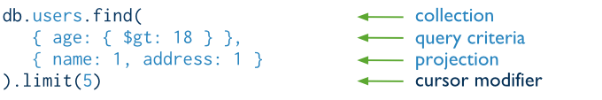
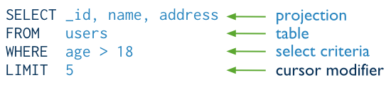
The components of a MongoDB find operation.
The next diagram shows the same query in SQL:
Notes:
38

Slide 39
SQL & Mongodb Commands
SQL SELECT Statements | MongoDB find() Statements
SELECT * FROM Teacher_info; | db.Teacher_info.find()
SELECT * FROM Teacher_info WHERE sal = 25000; | db.Teacher_info.find( {sal: 25000})
SELECT Teacher_id FROM Teacher_info WHERE Teacher_id = 1; | db.Teacher_info.find( {Teacher_id: "pic001"})

Slide 40
SQL & Mongodb Commands
SELECT * FROM Teacher_info WHERE status != "A“; | db.Teacher_info.find({status:{$ne:"A"}})
SELECT * FROM Teacher_info WHERE status = "A" AND sal = 20000; | db.Teacher_info.find({status:"A", sal:20000})
SELECT * FROM Teacher_info WHERE status = "A" OR sal = 50000; | > db.Teacher_info.find( { $or: [ { status: "A" } , { sal:50000 } ] } )
SELECT * FROM Teacher_info WHERE sal > 40000 | db. Teacher_info.find( { sal: { $gt: 40000 } } )
SELECT * FROM Teacher_infoWHERE sal < 30000 | db. Teacher_info.find( { sal: { $lt: 30000 } } )

Slide 41
SQL & Mongodb Commands
SELECT * FROM Teacher_info WHERE status = "A" ORDER BY SAL ASC | db. Teacher_info.find( { status: "A" } ).sort( { sal: 1 } )
SELECT * FROM users WHERE status = "A" ORDER BY SAL DESC | db. Teacher_info.find( { status: "A" } ).sort( {sal: -1 } )
SELECT COUNT(*) FROM Teacher_info; | db. Teacher_info.count() or db. Teacher_info.find().count()
SELECT DISTINCT(Dept_name) FROM Teacher_info; | db. Teacher_info.distinct( “Dept_name" )

Slide 42
Update Records
UPDATE Teacher_info SET Dept_name = “ETC" WHERE sal > 250000 | db. Teacher_info.update( { sal: { $gt: 25000 } }, { $set: { Dept_name: “ETC" } }, { multi: true } )
UPDATE Teacher_infoSET sal = sal + 10000 WHERE status = "A" | db. Teacher_info.update( { status: "A" } , { $inc: { sal: 10000 } }, { multi: true } )

Slide 43
Delete Records
DELETE FROM Teacher_info WHERE Teacher_id = “pic001" | db.Teacher_info.remove({Teacher_id: "pic001"});
DELETE FROM Teacher_info; | db. Teacher_info.remove({})

Slide 44

This Is My WordPress Blog
https://drronakpanchal.wordpress.com/

Slide 45
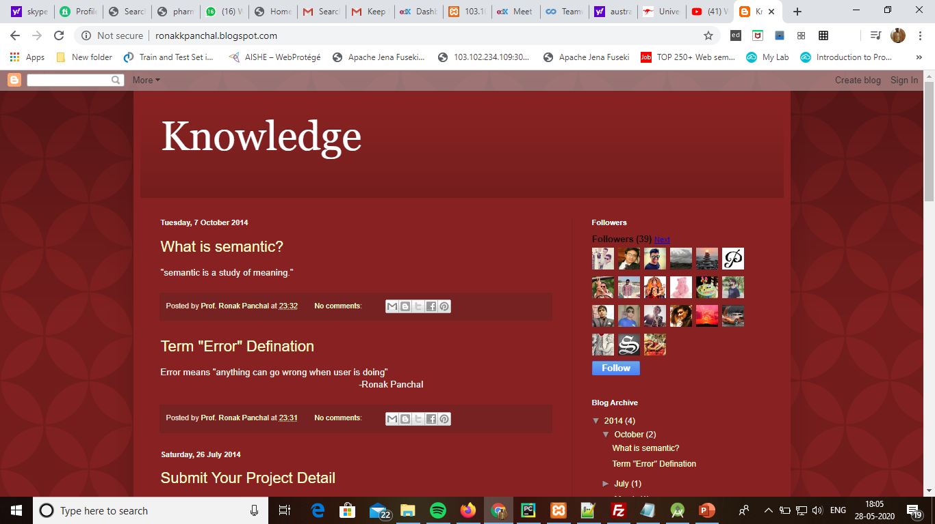
my first blog

Slide 46
Thank You Question & Answer https://drronakpanchal.wordpress.com/ +919898257016 dr.ronak.k.Panchal@gmail.com

